Slide 1
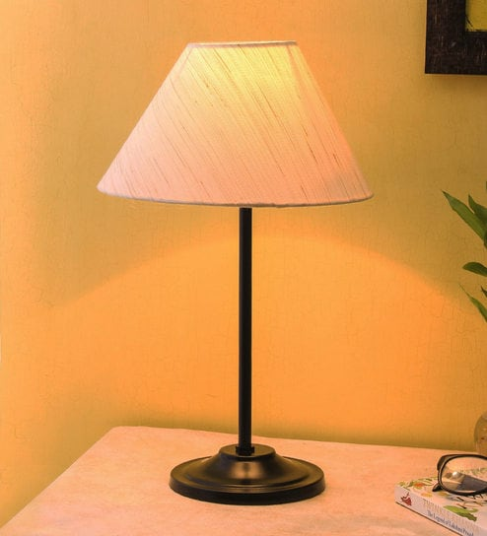
WELCOME
Mobile And Application Development

Slide 2

Sending SMS in Android
Mobile And Application Development
Practical
Instructor: Muhammad Naeem Khan

Slide 3
SENDING SMS
What is the use of the SmsManager Class?
SMSManager class manages operations like sending text messages, data messages, and multimedia messages (MMS). For sending a text message method sendTextMessage() is used likewise for multimedia message sendMultimediaMessage() and for data message, the sendDataMessage() method is used.
The details of each function are:

Slide 4
Methods of Sending SMS
Function | Description
sendTextMessage() | sendTextMessage(String destinationAddress, String scAddress, String text, PendingIntent sentIntent, PendingIntent deliveryIntent, long messageId)
sendDataMessage() | sendDataMessage(String destinationAddress, String scAddress, short destinationPort, byte[] data, PendingIntent sentIntent, PendingIntent deliveryIntent)
sendMultimediaMessage() | sendMultimediaMessage(Context context, Uri contentUri, String locationUrl, Bundle configOverrides, PendingIntent sentIntent

Slide 5
STEPS
Step 1: Create a new Android Application.
Step 2: Go to AndroidManifest.xml.
app->Manifest->AndroidManifest.xml
Step 3: In AndroidManifest.xml add the permission to send SMS. It will permit an android application to send SMS.
<uses-permission android:name=" android.permission.SEND_SMS " />

Slide 6
Activity_main
activity_main.xml
<?xml version="1.0" encoding="utf-8"?> <LinearLayout xmlns:android="http://schemas.android.com/apk/res/android" android:layout_width="match_parent" android:layout_height="match_parent" android:gravity="center_horizontal" android:orientation="vertical"> <ImageView android:id="@+id/imageView" android:layout_width="120dp" android:layout_height="120dp" android:layout_marginTop="60dp" android:src="@drawable/gfg_icon" /> <LinearLayout android:layout_width="match_parent" android:layout_height="wrap_content" android:layout_marginStart="16dp" android:layout_marginTop="32dp" android:layout_marginEnd="16dp" android:orientation="horizontal"> | <TextView android:id="@+id/textView" android:layout_width="wrap_content" android:layout_height="wrap_content" android:text="Phone Number:" android:width="165sp" android:textSize="18sp" /> <EditText android:id="@+id/editText" android:layout_width="0dp" android:layout_height="wrap_content" android:layout_weight="1" android:ems="10" android:hint="Enter number" android:inputType="phone" /> </LinearLayout> <LinearLayout android:layout_width="match_parent" android:layout_height="wrap_content" android:layout_marginStart="16dp" android:layout_marginTop="32dp" android:layout_marginEnd="16dp" android:orientation="horizontal">

Slide 7
Activity_main
activity_main.xml
<TextView android:id="@+id/textView2" android:layout_width="wrap_content" android:layout_height="wrap_content" android:text="Message to be Sent:" android:width="165sp" android:textSize="18sp" /> <EditText android:id="@+id/editText2" android:layout_width="0dp" android:layout_height="wrap_content" android:layout_weight="1" android:ems="10" android:gravity="top|start" android:hint="Enter message" android:inputType="textMultiLine" /> </LinearLayout> | <Button android:id="@+id/button" android:layout_width="wrap_content" android:layout_height="wrap_content" android:layout_gravity="center_horizontal" android:layout_marginTop="32dp" android:text="SEND" /> </LinearLayout>

Slide 8
Java code
Main_Activity.Java
package com.example.gfg; import androidx.appcompat.app.AppCompatActivity; import android.os.Bundle; import android.telephony.SmsManager; import android.view.View; import android.widget.Button; import android.widget.EditText; import android.widget.Toast; public class MainActivity extends AppCompatActivity { EditText phonenumber,message; Button send; @Override protected void onCreate(Bundle savedInstanceState) { super.onCreate(savedInstanceState); setContentView(R.layout.activity_main); send=findViewById(R.id.button); phonenumber=findViewById(R.id.editText); message=findViewById(R.id.editText2); | send.setOnClickListener(new View.OnClickListener() { public void onClick(View view) { String number=phonenumber.getText().toString(); String msg=message.getText().toString(); try { SmsManager smsManager=SmsManager.getDefault(); smsManager.sendTextMessage(number,null,msg,null,null); Toast.makeText(getApplicationContext(),"Message Sent",Toast.LENGTH_LONG).show(); }catch (Exception e) { Toast.makeText(getApplicationContext(),"Some fields is Empty",Toast.LENGTH_LONG).show(); } } }); } }

Slide 9
Thank You

